Slide 1
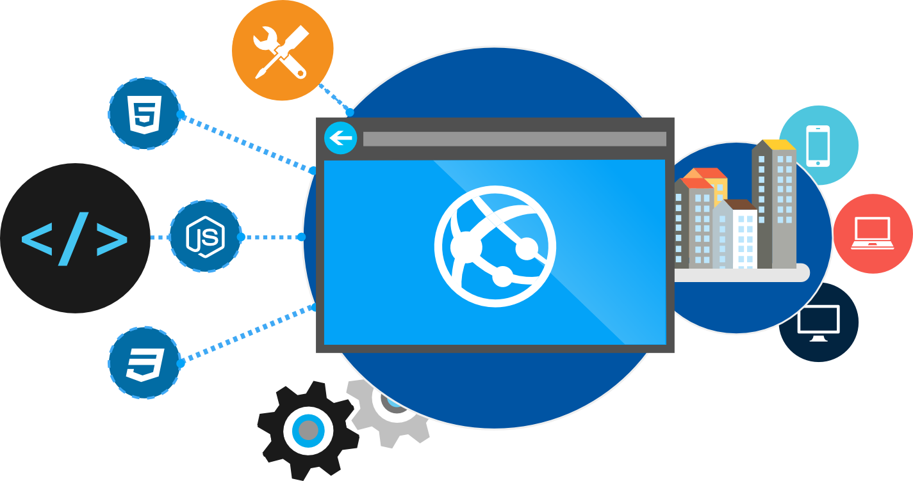
Docker Fundamentals Getting Started with Container Technologies
James Sturtevant
@aspenwilder
//jamessturtevant
Notes:
Going to take you back to a time before shipping standards were in place.

Slide 2
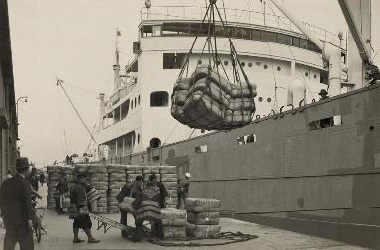
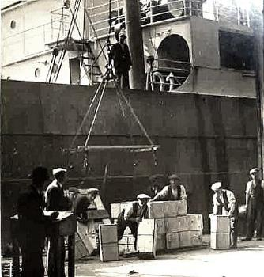
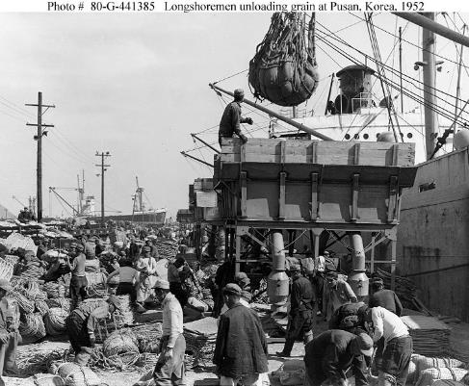
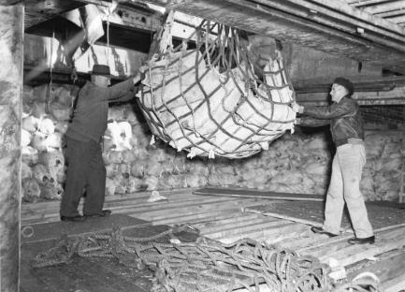
Before Container Standards
Notes:
Going to take you back to a time before shipping standards were in place.
Everything was loaded individual. Took lots of man power. Items would get mixed and matched. Items would be all over the ship.

Slide 3
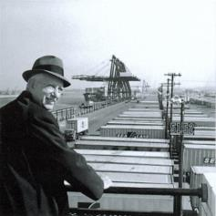
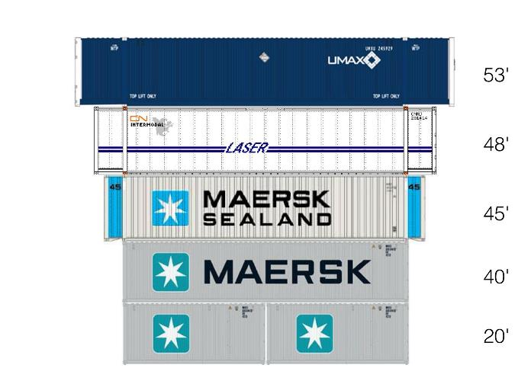
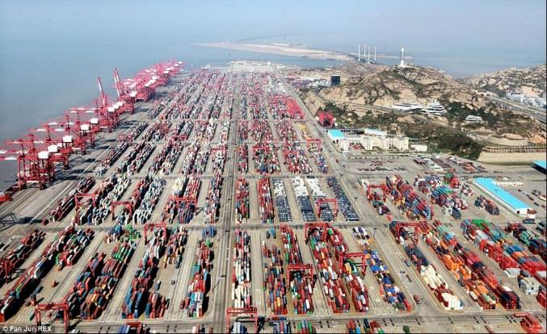
Shipping Containers Invented
In 1956, most cargo was loaded and unloaded by hand. Hand-loading a ship cost $5.86 a ton.
Malcom McLean born in 1913 developed the modern intermodal shipping container, which revolutionized transport and international trade.
McLean knew "A ship earns money only when she's at sea," and based his business on that efficiency.
Using containers, it cost only 16 cents a ton, a 39-fold savings. Containerization also greatly reduced the time to load and unload ships, improving reliability.
https://en.wikipedia.org/wiki/Malcom_McLean
Notes:
It was such a tough and demanding process that the were able to cut the savings by 39X. Imrpoved reliability by putting everything in the same conatieers. Faster load process.
It was so revolutionary that today we can’t event image a situation with containers.
Container techonology in software is likely to feel the same way in a few years. We won’t be able to dream a time with out it.
As far as the cost saving goes I would say that you would likely see something similar if we were as good about tracking cost and effort in software. Im not sure that many of us are thought we are moving forward as in industry.

Slide 4
What is a container?
Traditional virtual machines = hardware virtualization
Application
VM
VM
VM
OS
Hardware

Slide 5
What is a container?
OS
Hardware
Traditional virtual machines = hardware virtualization
Application
VM
VM
VM
OS
Hardware

Slide 6
What is a container?
Containers = Operating system virtualization
OS
Applications
Kernel
Hardware
Traditional virtual machines = hardware virtualization
Application
VM
VM
VM
OS
Hardware

Slide 7
What is a container?
Containers = Operating system virtualization
OS
CONTAINER
CONTAINER
CONTAINER
Applications
Kernel
Hardware
Traditional virtual machines = hardware virtualization
Application
VM
VM
VM
OS
Hardware

Slide 8
App A
App A’
App B
Containers are isolated, but share OS and, where appropriate, bins/libraries
Bins/Libs
Bins/Libs
Bins/Libs
Guest OS
Guest OS
Guest OS
App A
App A’
App B
App B’
App B
App B’
App B
App B’
Bins/Libs
Bins/Libs
Hypervisor
Docker Engine
Host OS
Host OS
Server
Server
Notes:
We have had a similar technology through the use of VM’s in the past but it was very heavy weight. It is like have a boat carry boats of boats full of shipping containers. Big beefy machines to hold other machines
With container technologies, to solution is much more light weight and is more like having the containers directly on the boat. You get a higher density of applications/verisons/services on one machine. This becomes really important for two reasons. First one is cost saving on you part. Less hardware is a good thing. Second we you start to talk at the scale like amazon or azure it means they can have higher density and that adds up quick and passing off saving to you.
Another thing to note here is the share bins libraries.
TRANSITION – OK you sold that containers are a good thing. How do I get started with Docker?

Slide 9
Docker, Docker, Docker
Notes:
Did I Mention about Docker
Containers have been around for many years
Docker Inc. did not invent them
created open source software to build and manage containers
Docker makes containers easy
Docker provides a container packaging format
creating a Docker hub ( a github of containers, more on it later)

Slide 10
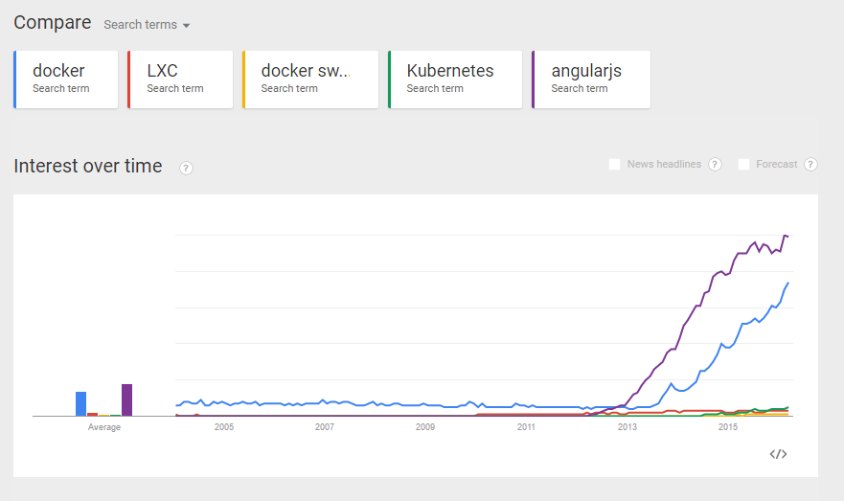

Slide 11
Container runtimes other than Docker
lxc
first linux containers implementation (again, not something in the kernel)
it was not really user friendly (did not have concept of images, CoW, hence docker happened)
used by Docker for quite a while, then got swapped out.
systemd-nspawn
Basically a Docker competitor by systemd, because why not.
rkt
by CoreOS, Docker competitor, focuses on a different set of problems
runC
a lightweight execution-focused implementation by Docker, soon to be used in Docker Engine.
Notes:
Namespaces and cnames. If you look through the source of linux you will not see the word container as we use it for this techonology
Cnames limit resources
Namespaces change world view of the container by making them seem like they are the only one.
Comon already…. Show me docker

Slide 12
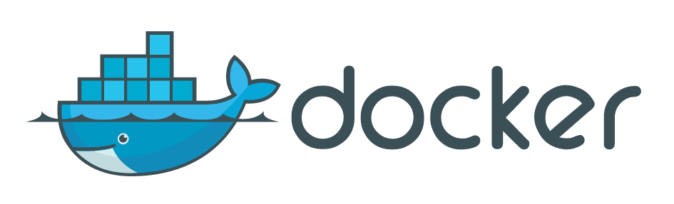
Notes:
Hopefully docker’s logo makes sense to you now.

Slide 13
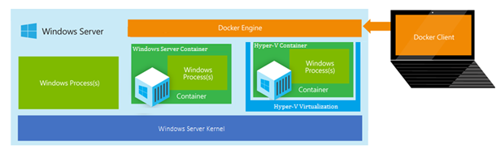
What about Windows?
Windows Server Containers - More density, less isolation
Hyper-V Containers – More Isolation, less density
Both just communicate using the Docker client/engine

Slide 14
What is a Windows container?
Containers = Operating system virtualization
OS
CONTAINER
CONTAINER
CONTAINER
Applications
Kernel
Hardware
Traditional virtual machines = hardware virtualization
Application
VM
VM
VM
OS
Hardware

Slide 15
What is a Windows container?
Containers = Operating system virtualization
Windows Server Containers
Maximum speed and density
OS
CONTAINER
CONTAINER
CONTAINER
CONTAINER
CONTAINER
CONTAINER
Applications
Kernel
Kernel
Hardware
Traditional virtual machines = hardware virtualization
Application
VM
VM
VM
OS
Hardware

Slide 16
Just like Linux containers…. With a bonus.
Containers = Operating system virtualization
Windows Server Containers
Maximum speed and density
OS
CONTAINER
CONTAINER
CONTAINER
CONTAINER
CONTAINER
CONTAINER
Applications
Kernel
Kernel
Hardware
Hyper-V Containers
Isolation plus performance
Traditional virtual machines = hardware virtualization
CONTAINER
CONTAINER
CONTAINER
Application
VM
VM
VM
OS
Kernel
Kernel
Kernel
Hyper-V
Hardware

Slide 17
Why containers?

Slide 18
How do containers make it easier?
Consistency
Efficiency
Rapid
Deployment
Fast Iterations
Service Separation
High Availability
Reproducibility
On Any Cloud
Scalability
Test at Scale
Immutability
Reduced Costs
Notes:
Reporducibility
Immutabliy
On an cloud
Scalablitliy
Reduced costs - desinity

Slide 19

Containers
Creation, deployment, and management
Developers update, iterate, and deploy updated containers
Physical/Virtual Servers
2
3
Operations collaborates with developers to provide app metrics and insights
Developers build and test apps in containers, using development environment
Operations automates deployment and monitors deployed apps from central repository
1
2
Containers pushed to central repository

Slide 20
Docker Specifics

Slide 21
Terminology
Docker Containers Actual running instance of a container (writable)
Docker Images ready-only (Immutable) templates that help define Docker containers
Read-Write Layer
Container
4
Read Layer
3
Read Layer
Image
2
Read Layer
1
Notes:
There is a lot more to this but for now that is all you need to know.
Think: objects are instantiation of class. Containers are instances of images.

Slide 22
Docker Run
Downloads image & creates & starts container
docker run hello-world
docker run -it ubuntu /bin/bash
Notes:
Interactive and telly type attached to it.

Slide 23
Terminology
Docker Host Containerization virtualization service
Docker Hub Sharing and managing images
Docker Containers Actual running of applications
Docker Client Communication between user and Docker Host
Docker Image ready-only templates that help launch Docker containers
DockerFile Instructions to automate image creation

Slide 24
Demo – 20 Web Servers faster than you can count to ...
Notes:
Docker run hello-world
docker run -it ubuntu /bin/bash
Docker start –I <conainter id>
Docker commit <container id> sample
for i in {1..20}; do docker run -d -p 80 tutum/hello-world; done
docker stop $(docker ps -q)

Slide 25
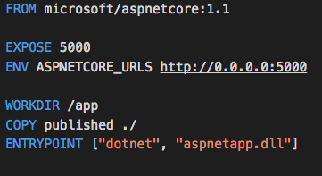
A Dockerfile is your “recipe”
A text file where you tell Docker what you want in your Docker image
Takes a snapshot every command, uses cache for performance
Notes:
How do you make these images and give commands and get files on to the containers?
The first FROM line tells Docker that we will use the official ASP.NET image on Docker Hub as our base image.
The COPY line tells Docker that we will copy contents of this folder (.) to the /app directory of the container and the WORKDIR instruction will move to the /app directory.
The RUN instruction tells Docker to run the dnu restore command to install the dependencies of the application. We do this before running out application for the first time.
he EXPOSE instruction will inform Docker that this image has a service which will be listening at port 5004 (see project.json of the sample file for details).
Lastly, the ENTRYPOINT instruction is the command executed to start the container and keep it up and running
https://blogs.msdn.microsoft.com/webdev/2015/01/14/running-asp-net-5-applications-in-linux-containers-with-docker/

Slide 26
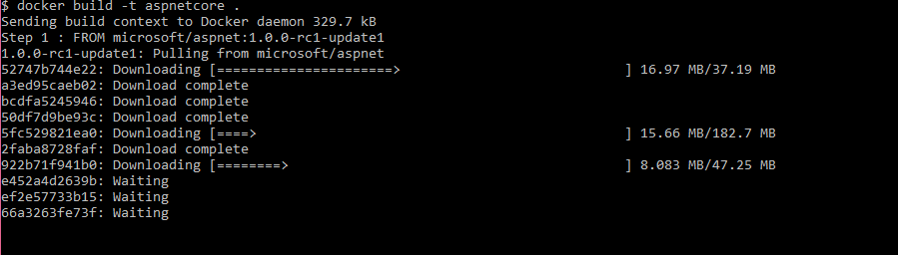
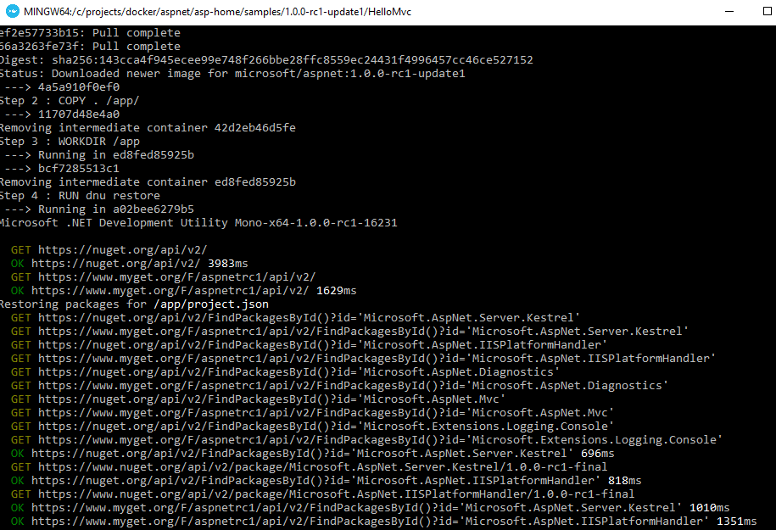
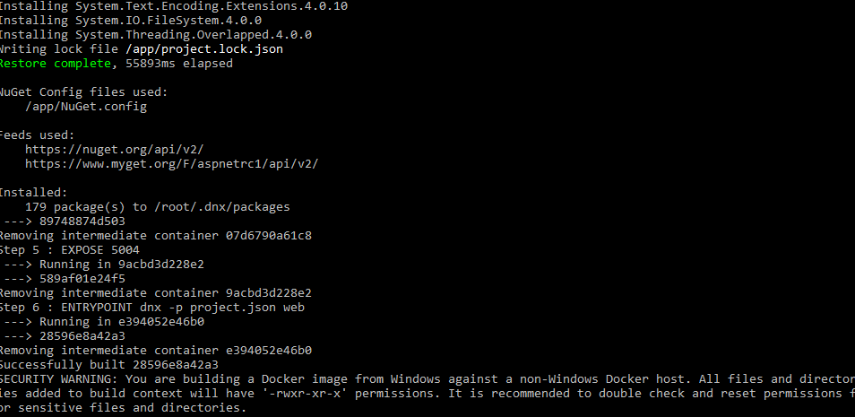
Docker Build
Creates the image
docker build –t aspnetcore .
Notes:
Everytime you change your app you re-run this.
docker build -t myapp .
-t give it a name.
Dot says to use files in the folder.

Slide 27
Image Registries
What is a registry?
Stores container images
Images are Pushed into a registry
Images are Pulled from a registry
Images are Searched for within a registry
Notes:
Ok great but what do I do with them now? How do I share?

Slide 28
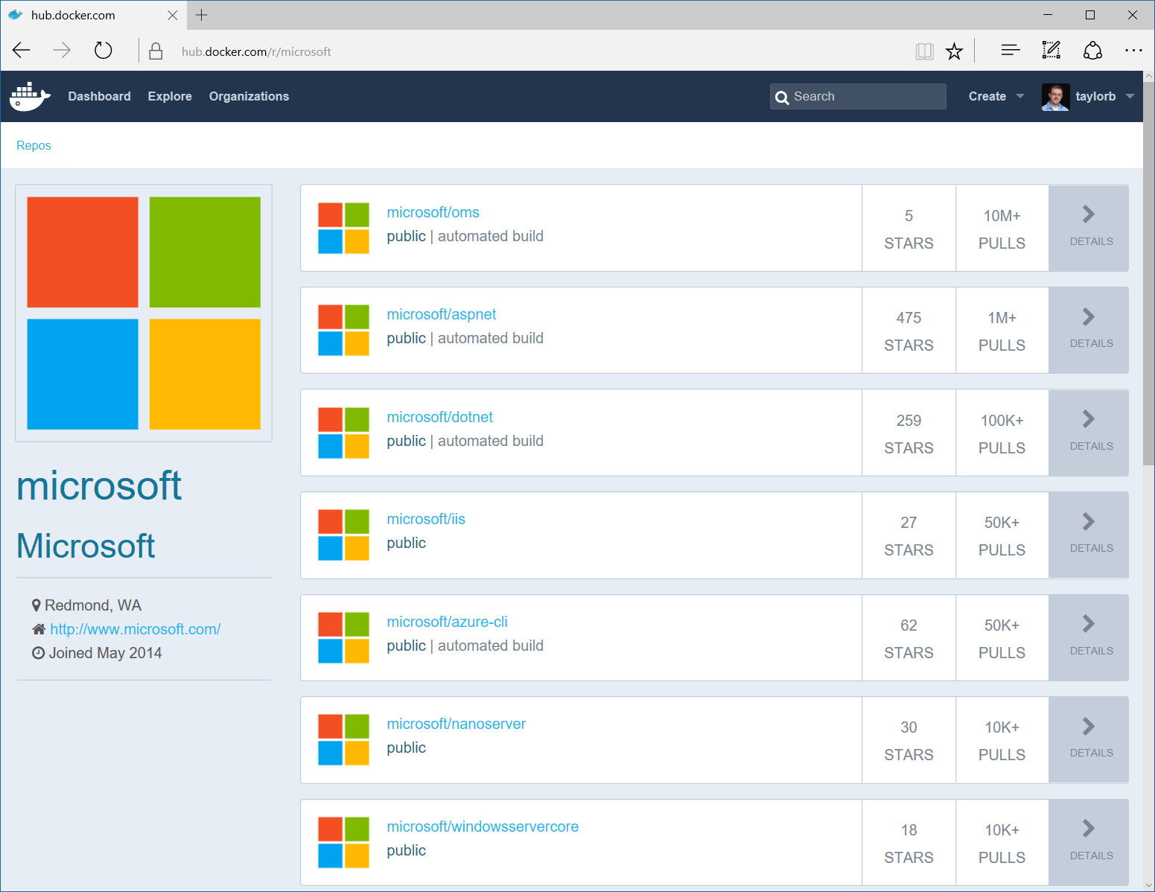
Image Registries
Docker Hub and Docker Store
Public, Official and Private image repositories
Docker Trusted Registry
Enterprise Grade Private Registries
Docker Registry
Open source foundation of Hub and DTR
Azure Container Registry
Currently in Preview
Store your container image in local, network-close storage on Azure
Notes:
Docker Hub and Docker Store
Public, Official and Private image repositories
Granular access controls with organization support
Automated image build support
Docker Trusted Registry
Enterprise Grade Private Registries
Runs on your infrastructure (on-prem or cloud)
Active Directory and Role Based Access Controls
Docker Registry
Open source foundation of Hub and DTR
Runs on your infrastructure (on-prem or cloud) as a container
https://docs.docker.com/registry and or https://github.com/docker/distribution
Azure Container Registry
Currently in Preview
Store your container image in local, network-close storage on Azure
Use Azure Active Directory to manage access
Manage Windows and Linux container images in a single registry

Slide 29
Demo – Build a new image and share it
Notes:
Push to docker hub.
Show Azure container registery.

Slide 30
You can do containers your way….

Slide 31
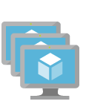
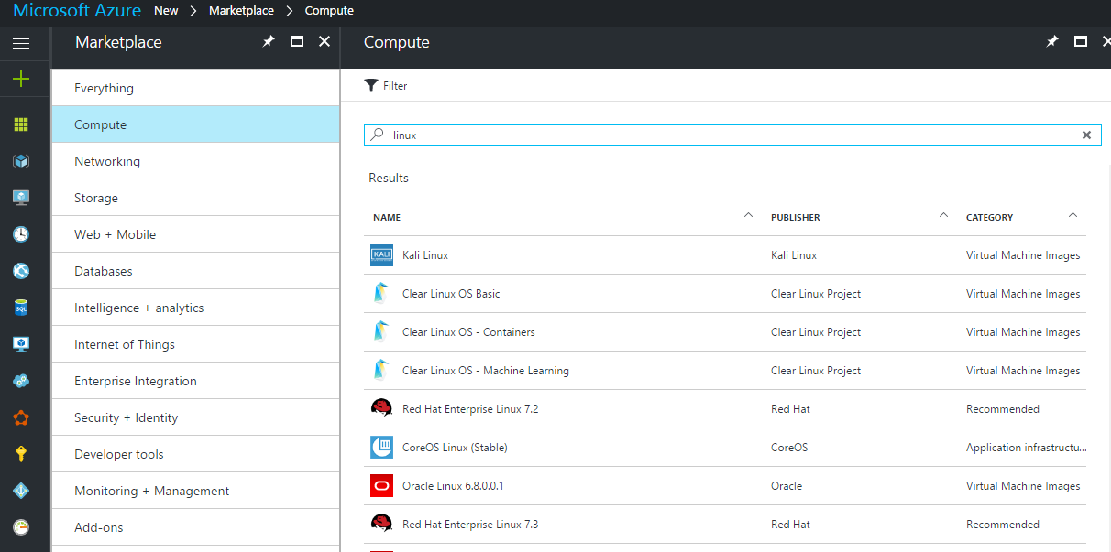
Linux Containers on Linux VMs

Slide 32
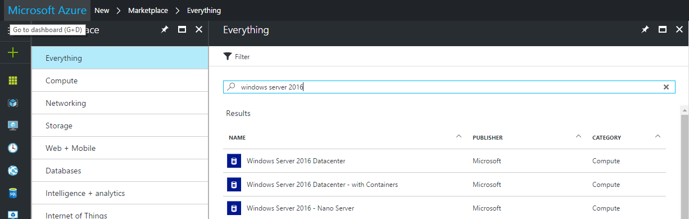
Windows Containers on Windows VMs

Slide 33


Azure App Service Web apps for Linux
Web apps
Web apps that scale with your business
Mobile apps
Build mobile apps for any device
Logic apps
Automate business processes across SaaS and on-premises
API apps
Easily build and consume APIs in the cloud
Functions
A serverless event based experience to accelerate your development.

Slide 34
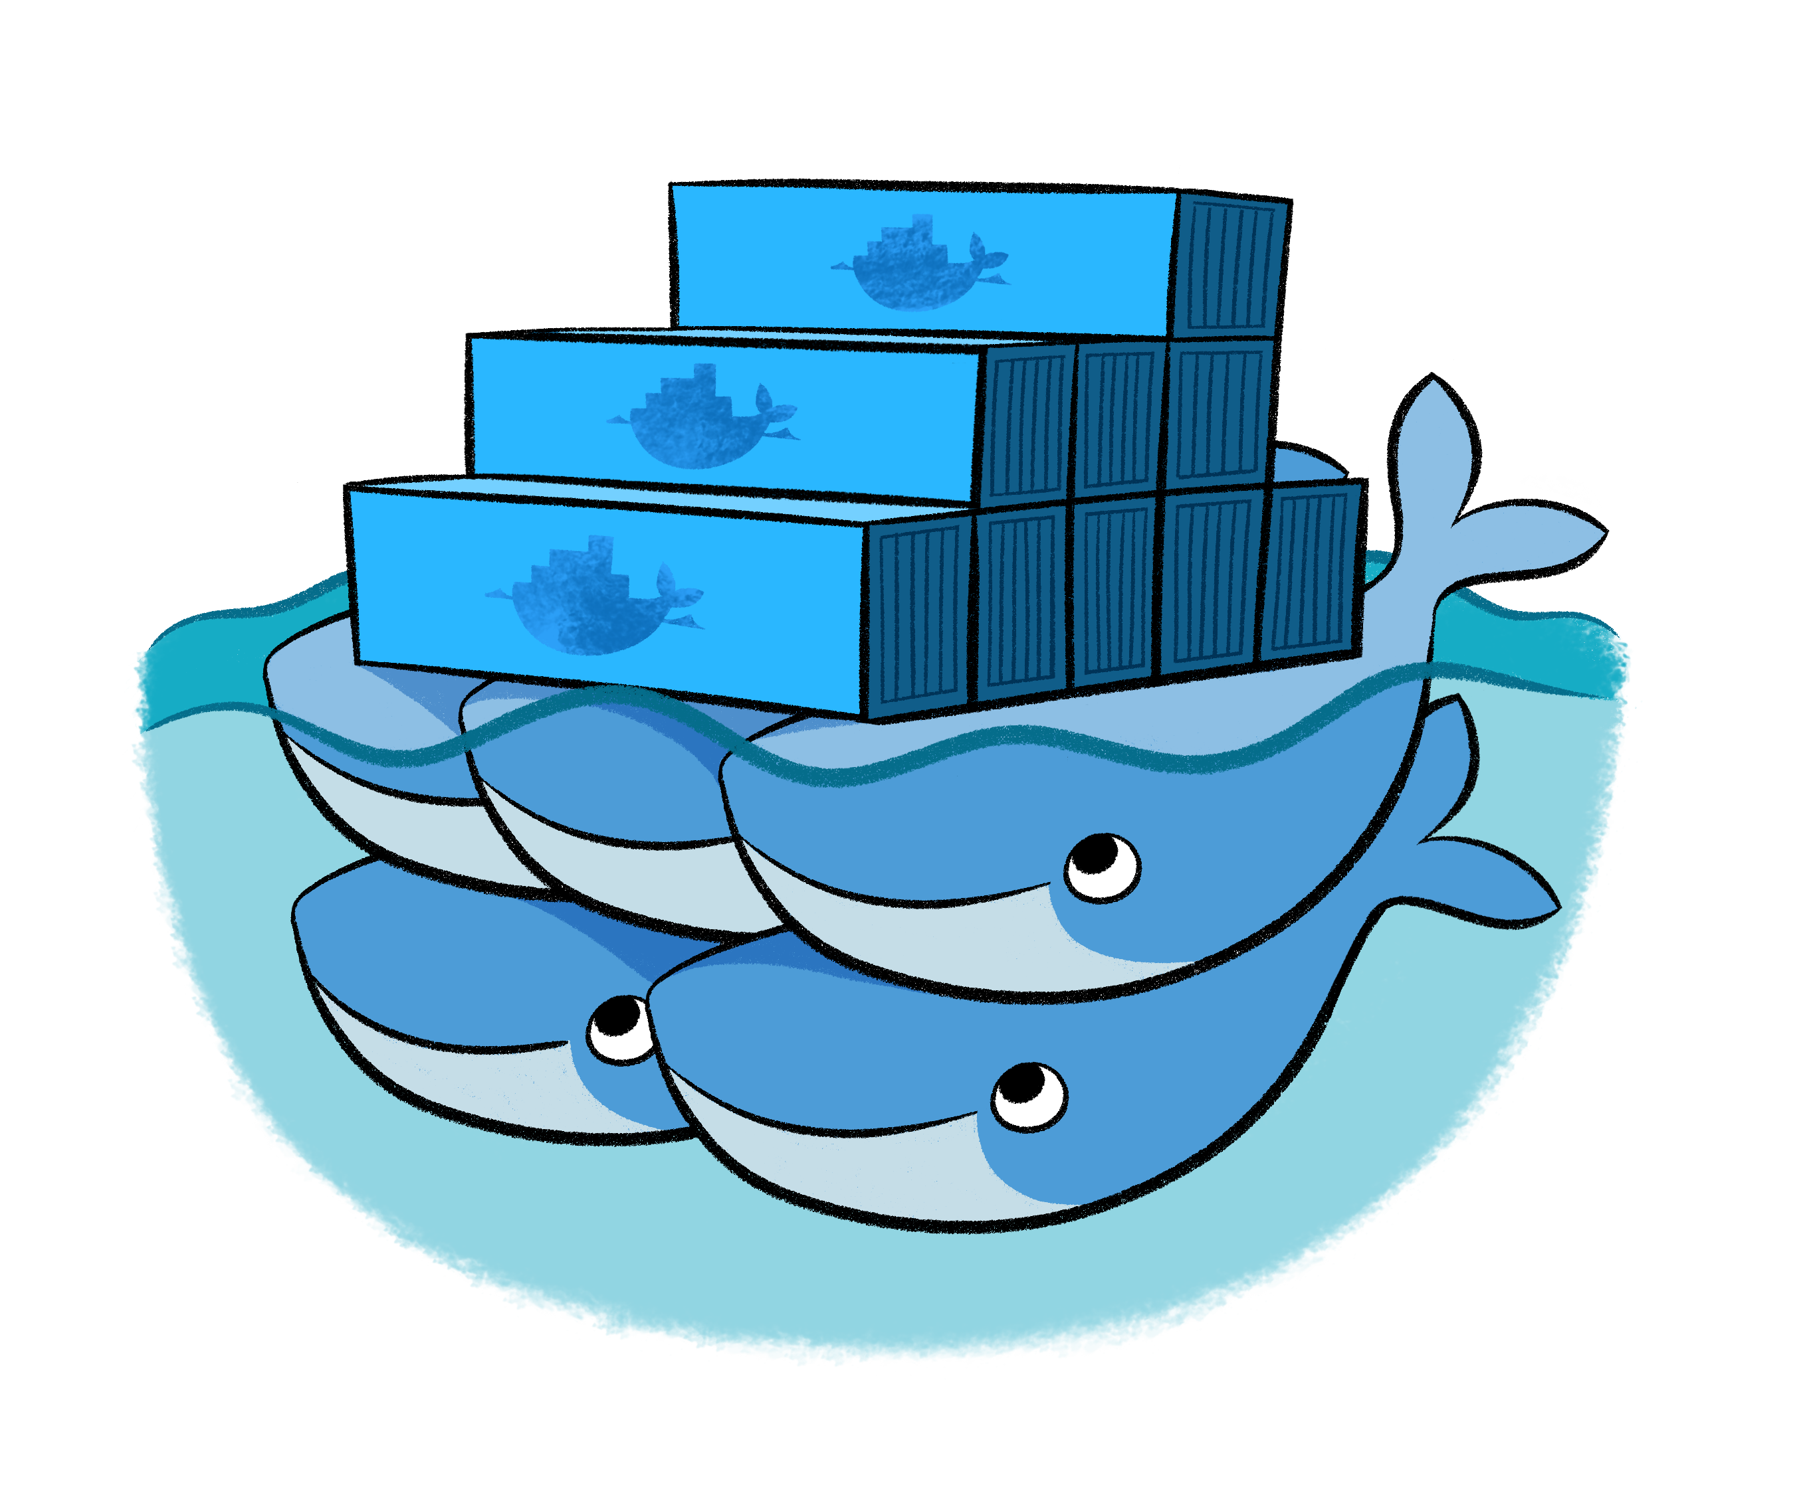
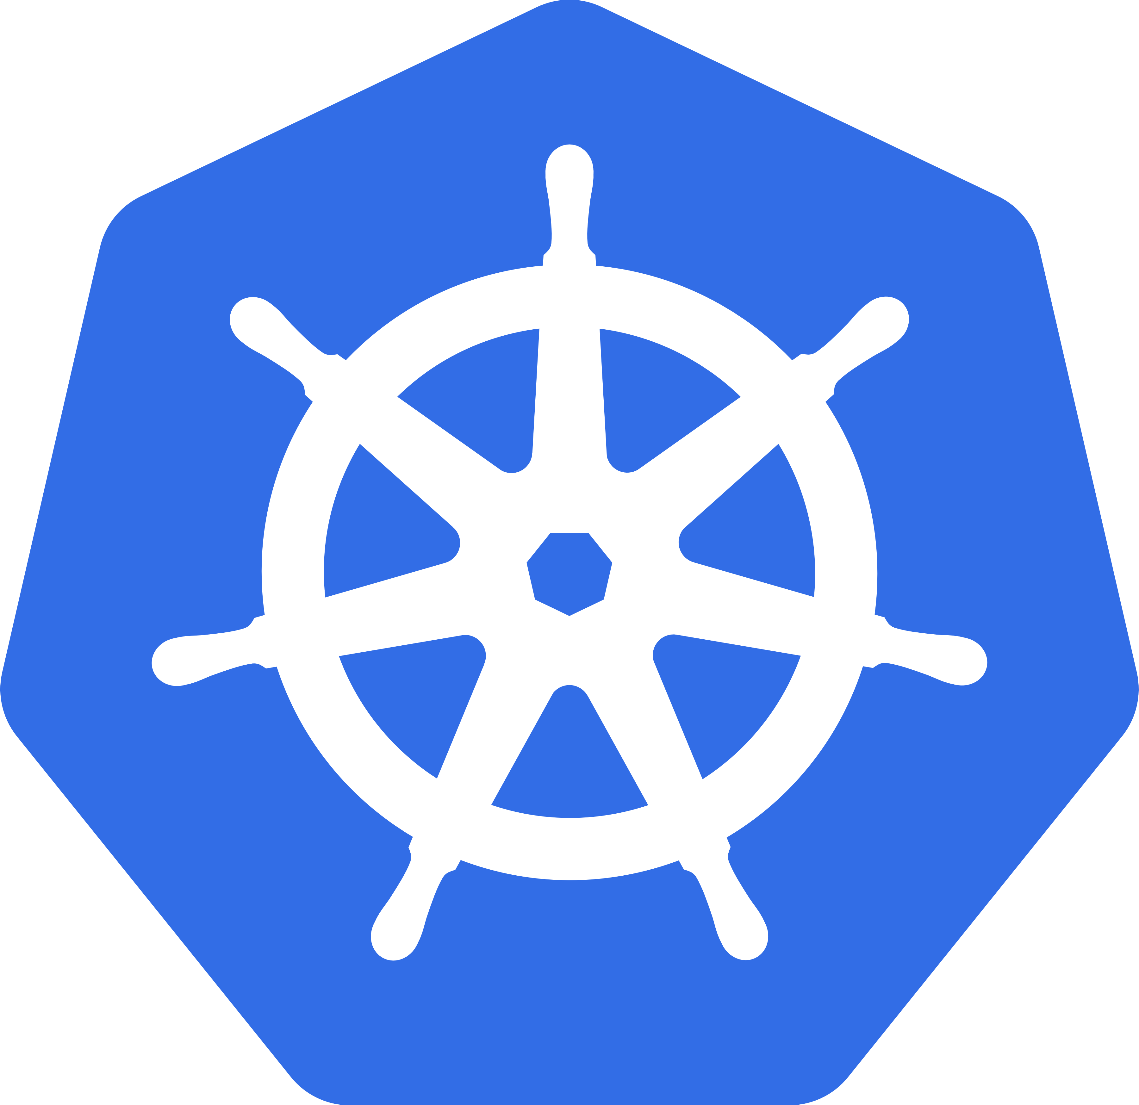

Linux Containers using Azure Container Services
With Docker Swarm, DC/OS or Kubernetes

Slide 35
Demo – Run images on the Cloud
Notes:
Shh into machine and run image previously created

Slide 36
Multiple containers (ssshhhh don’t say microservices)

Slide 37
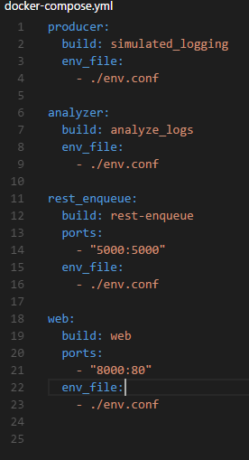
Docker Compose
Defining and running multi-container Docker applications.
Configure your application’s services. Then, using a single command, you create and start all the services from your configuration.
Notes:
So far we have only talked about a single docker container but in reality you will have multiple.
Here we have an example of an application with producer, queue, and analyzer (consumer) and web portal for the whole process.
Here they are composed together as a single application and a single command lets you launch them all together.
docker-compose up
https://github.com/rgardler/acs-demos

Slide 38
Demo – Compose locally
Notes:
Docker comose up

Slide 39
Automation and Management

Slide 40

Composition and Orchestration
Applications typically comprised of multiple containers
Containers typically hosted across a cluster of nodes
Orchestration tooling automates this

Slide 41
Composition and Orchestration
Docker Swarm
Aggregate container hosts
Supports tagging, affinity/anti-affinity

Slide 42
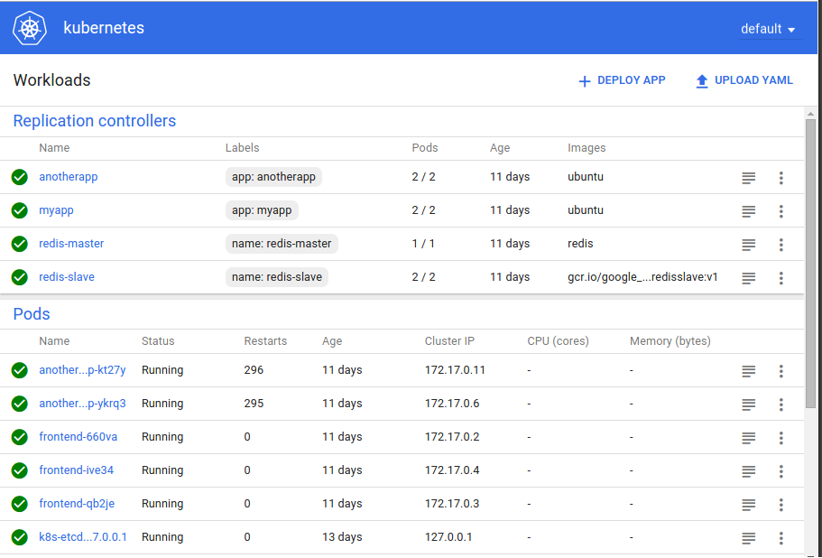
Composition and Orchestration
Kubernetes
Open source project started by Google
Windows support being added though community partnership spear headed by Apprenda

Slide 43
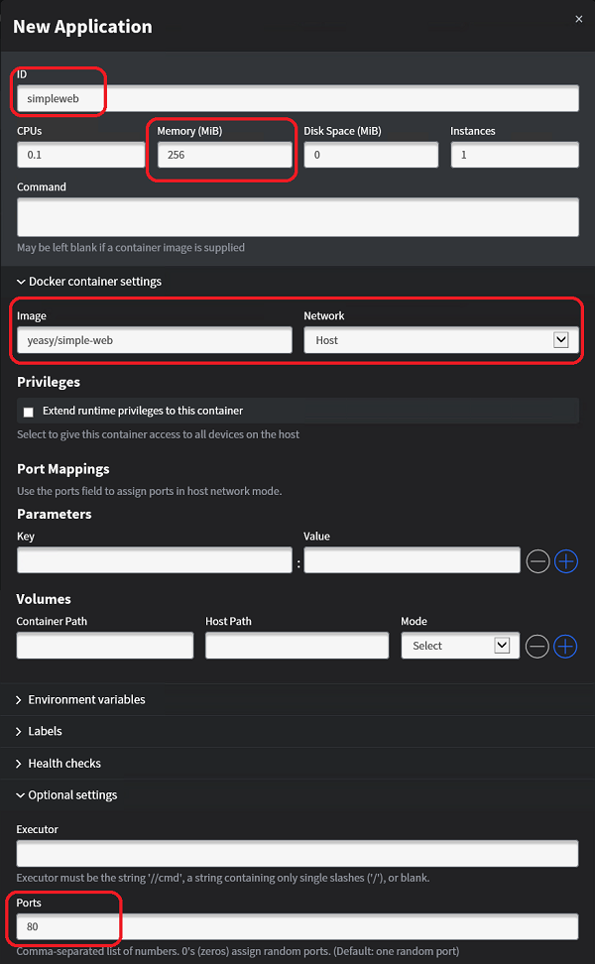
Composition and Orchestration
Mesos/Mesosphere + Marathon
Aggregates container hosts
Web based UI
Service Launch and Discovery

Slide 44
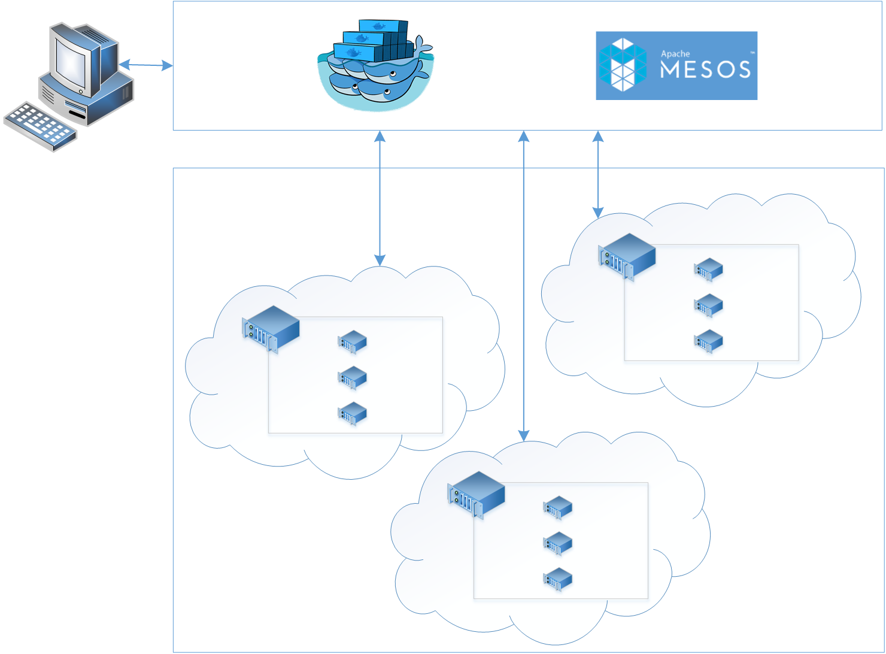
Azure Container Services
App1
App2

Slide 45
Handling machine failures
App1
App2

Slide 46
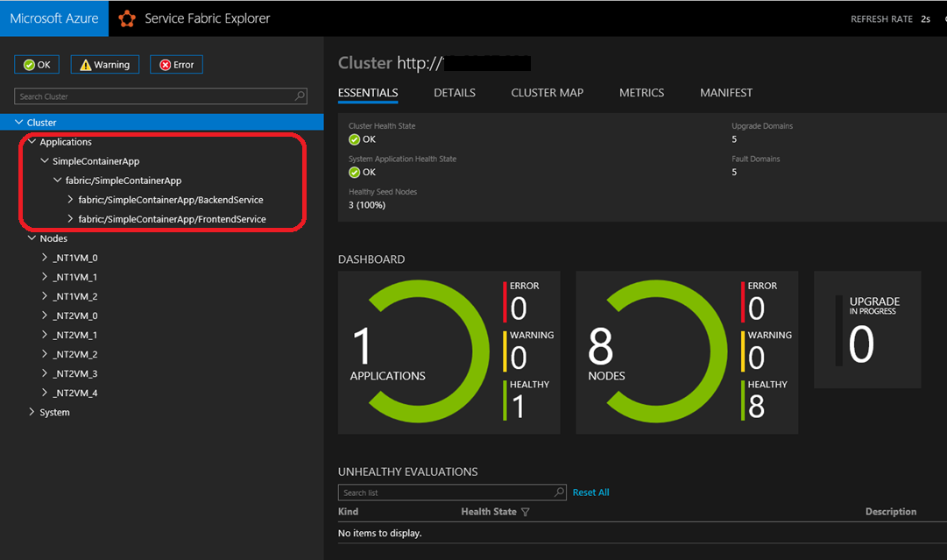

Composition and Orchestration
Azure Service Fabric
Microservice and orchestration platform
Build applications as containers and/or microservice
Available on Windows & Linux
Built-in cross-container communication
Web based management UI
Available On-Prem, Azure or other Clouds
Can orchestrate anything:
A random exe, some java app,
a containerized app or a microservice
that uses Service Fabric’s APIs
Notes:
Service Fabric supports orchestrating containers as well as processes across a cluster of machines. It can orchestrate anything whether it’s a random exe, some java app, a containerized application, or an actual microservice that takes advantage of Service Fabric’s programming model APIs.

Slide 47


Azure Container Service
Azure
Standard Docker tooling and API support
Streamlined provisioning of Docker Swarm, DCOS and recently Kubernetes
Linux and Windows Server containers
Azure and Azure Stack
Swarm
DC/OS

Slide 48
Demo – Swarm
Notes:
docker info
ssh -L 2375:localhost:2375 -f -N jsturtevant@swarm-demomgmt.eastus.cloudapp.azure.com -p 2200
export DOCKER_HOST=:2375
docker info
docker-compose -f docker-compose.yml up

Slide 49
What about…

Slide 50
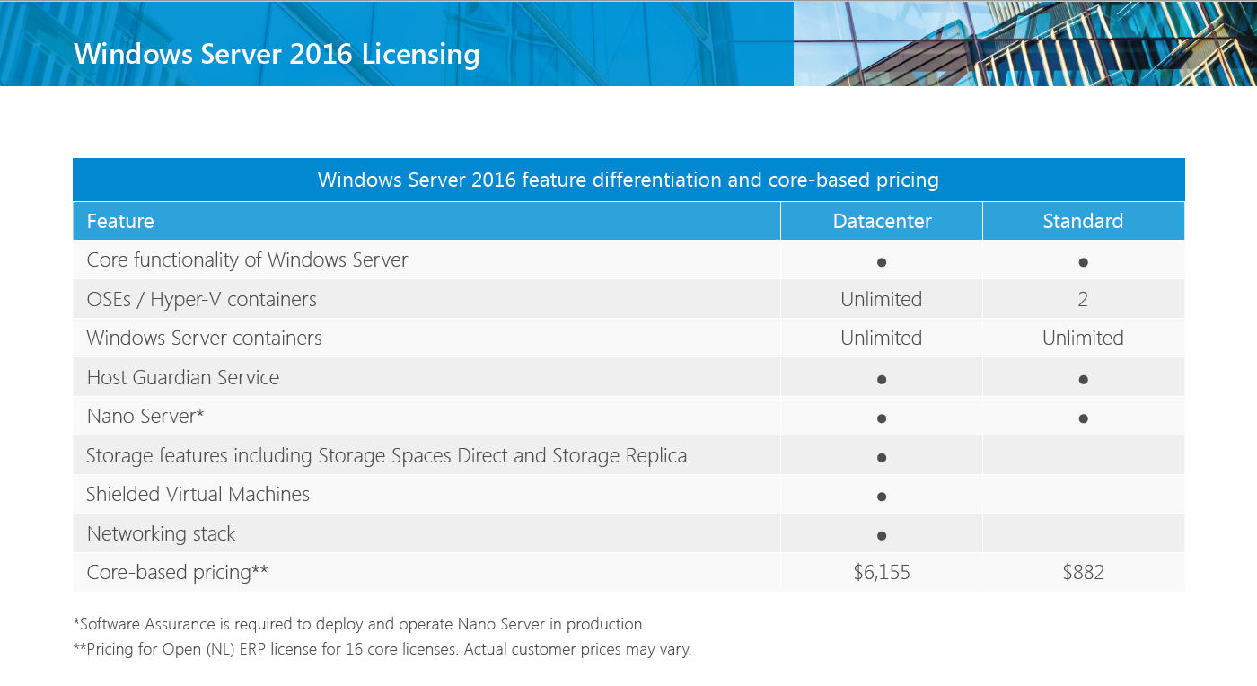
Licensing
https://www.microsoft.com/en-us/cloud-platform/windows-server-pricing

Slide 51

Patching and Updates
Update Container OS Image
Pull updated base image
Rebuild containers using dockerfiles
My Website
IIS
10.0.14393.0

Slide 52
Patching and Updates
Update Container OS Image
Pull updated base image
Rebuild containers using dockerfiles
My Website
IIS
10.0.14393.0

Slide 53
Patching and Updates
Update Container OS Image
Pull updated base image
Rebuild containers using dockerfiles
My Website
IIS
KB123456 = new image on Docker Hub
10.0.14393.0
10.0.14393.1

Slide 54
Patching and Updates
Update Container OS Image
Pull updated base image
Rebuild containers using dockerfiles
My Website
IIS
IIS
FROM windowsservercore
RUN powershell –command Add-WindowsFeature Web-Server
KB123456 = new image on Docker Hub
10.0.14393.0
10.0.14393.1

Slide 55
Patching and Updates
Update Container OS Image
Pull updated base image
Rebuild containers using dockerfiles
My Website
My Website
FROM iis
ADD mysite.htm inetpub\mysite.htm
IIS
IIS
FROM windowsservercore
RUN powershell –command Add-WindowsFeature Web-Server
KB123456 = new image on Docker Hub
10.0.14393.0
10.0.14393.1

Slide 56
Patching and Updates
Update as a new layer
Download update in container (ala run Windows Update in the container)
When container is stopped update is applied as a new layer
My Website
IIS
10.0.14393.0

Slide 57
Patching and Updates
Update as a new layer
Download update in container (ala run Windows Update in the container)
When container is stopped update is applied as a new layer
My Website
IIS
10.0.14393.0

Slide 58
Patching and Updates
Update as a new layer
Download update in container (ala run Windows Update in the container)
When container is stopped update is applied as a new layer
My Website
IIS
Same Image
10.0.14393.0
10.0.14393.0

Slide 59
Patching and Updates
Update as a new layer
Download update in container (ala run Windows Update in the container)
When container is stopped update is applied as a new layer
My Website
My Website
Same Image
IIS
IIS
Same Image
Same Image
10.0.14393.0
10.0.14393.0

Slide 60
Patching and Updates
Update as a new layer
Download update in container (ala run Windows Update in the container)
When container is stopped update is applied as a new layer
KB123456
My Website
My Website
Same Image
IIS
IIS
Same Image
Same Image
10.0.14393.0
10.0.14393.0

Slide 61

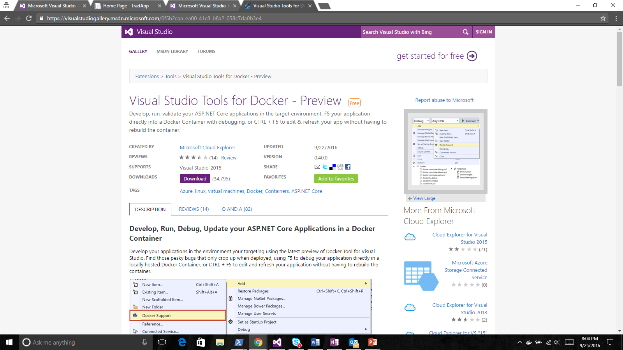
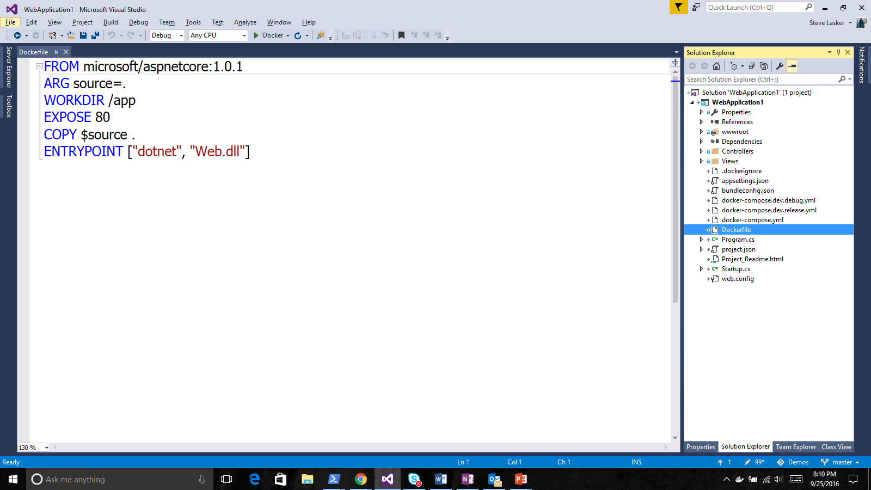
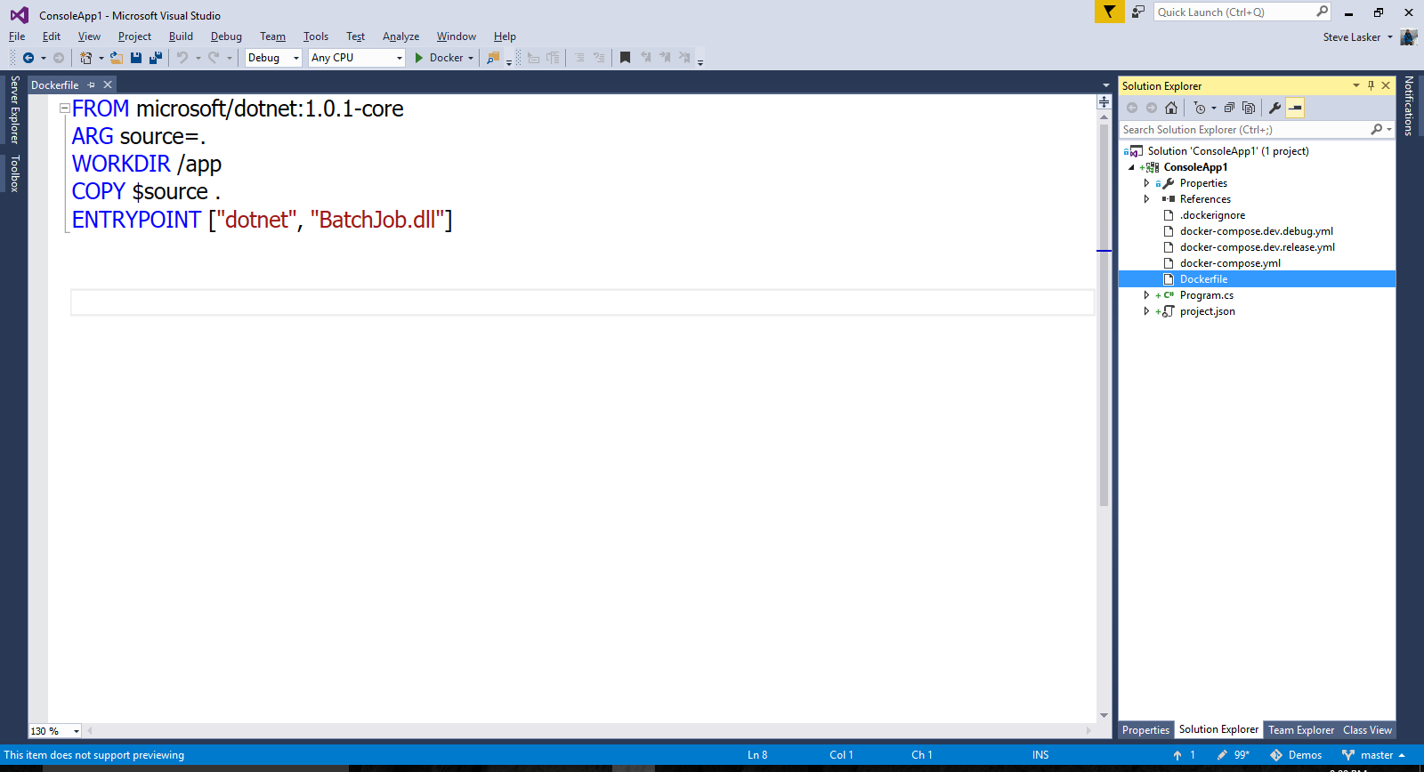
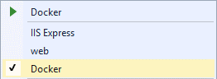
Visual Studio Docker Tools
Run, Debug, Test Web & Console apps in docker containers
Linux today, Windows Server & Nano Server coming soon
F5 Debugging
Edit & Refresh of code
Scaffolds docker assets
Dockerfile, docker-compose.yml
aka.ms/DockerToolsForVS

Slide 62
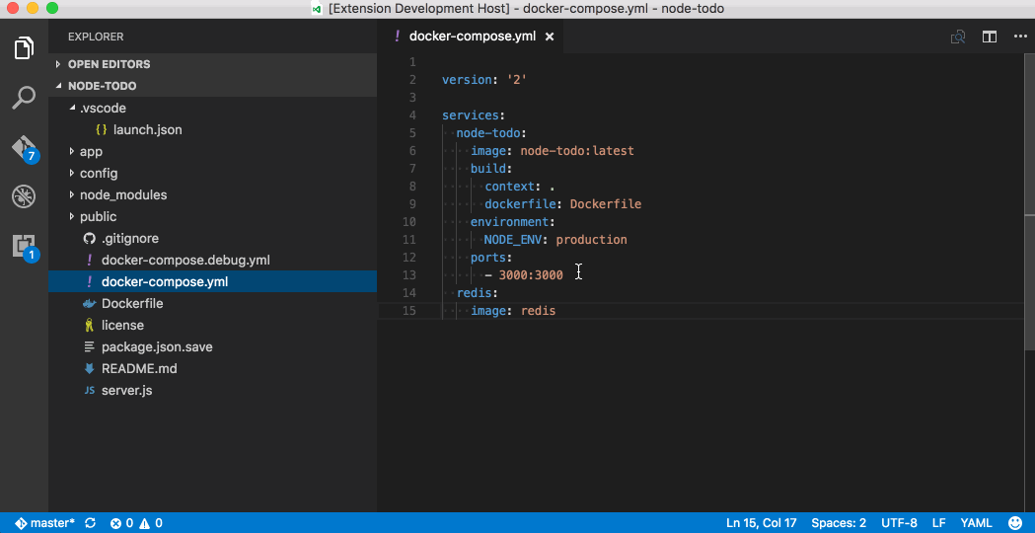
VS Code

Slide 63
Think Differently
Think: Modular Design
Think: Microservices
Think: Composable
Think: Scalable Units
Think: Immutable
Think: Swappable Units
Notes:
^{(Tax Calc for 2015/2012)}

Slide 64
Additional Information
https://github.com/tripdubroot/ContainerCamp
https://marketplace.visualstudio.com/items?itemName=PeterJausovec.vscode-docker
https://docs.microsoft.com/en-us/azure/container-service/
https://docs.docker.com/

Slide 65
Thank you!
James Sturtevant
@aspenwilder
//jamessturtevant
Aka.ms/jsch9

Slide 66
Common questions
Docker client versus host
Docker client is a command line interface (CLI) Docker
Docker host is a Linux/Windows VM running Docker daemon (REST available)
Docker Linux and Windows hosts
You can only create the same container as the underlying host VM - Linux host = Linux containers
Docker Image vs Docker Container
Image = The definition – literally a single file [My Website]
Container – An instance of an image [3 instances of My Website]

Slide 67
Identify the scaling boundaries
Front End
Logic
(API)
Email Campaigns
Product Mgmnt
Customer Service
Basket Mgmnt
Payment Gateway
Product Info
Shopper Profile
Order Status
Order Status
Basket Mgmnt
Checkout
Back Office
Customer Mgmnt
Product Info
Caching
Persistence

Slide 68
Data center without containers

Slide 69
Data center with containers

